Slide 1
Sprint Review 2
Importing Excel Data into SQLite Studio Database/Tables

Slide 2
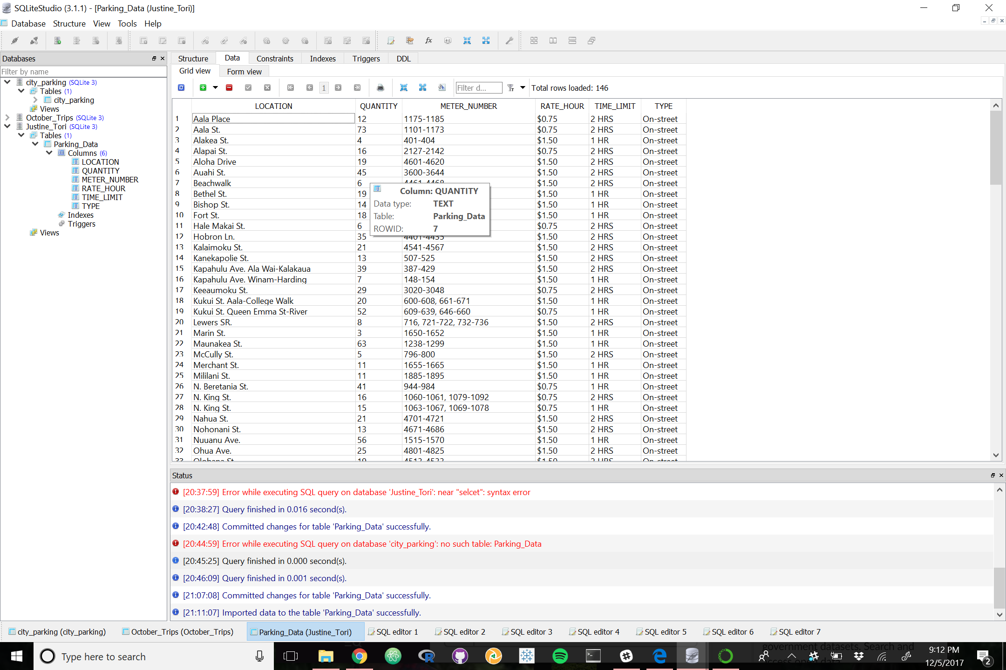
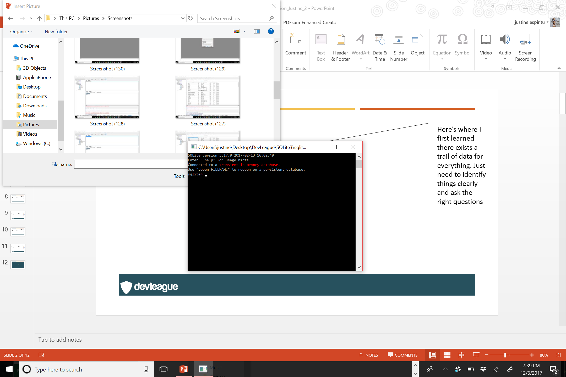
SQLite3 Command Line
I prefer to work with SQLite databases using an intuitive GUI tool.

Slide 3
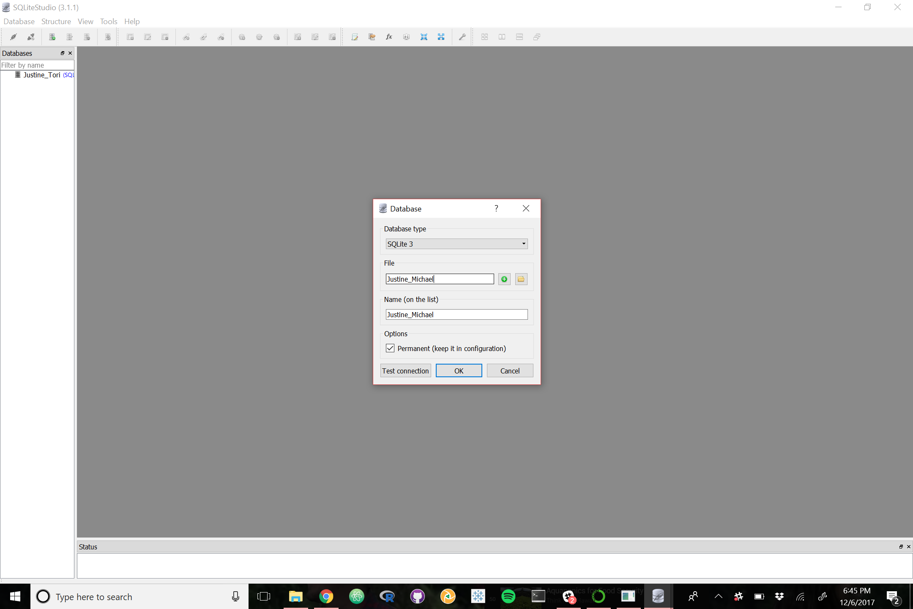

Slide 4


Slide 5
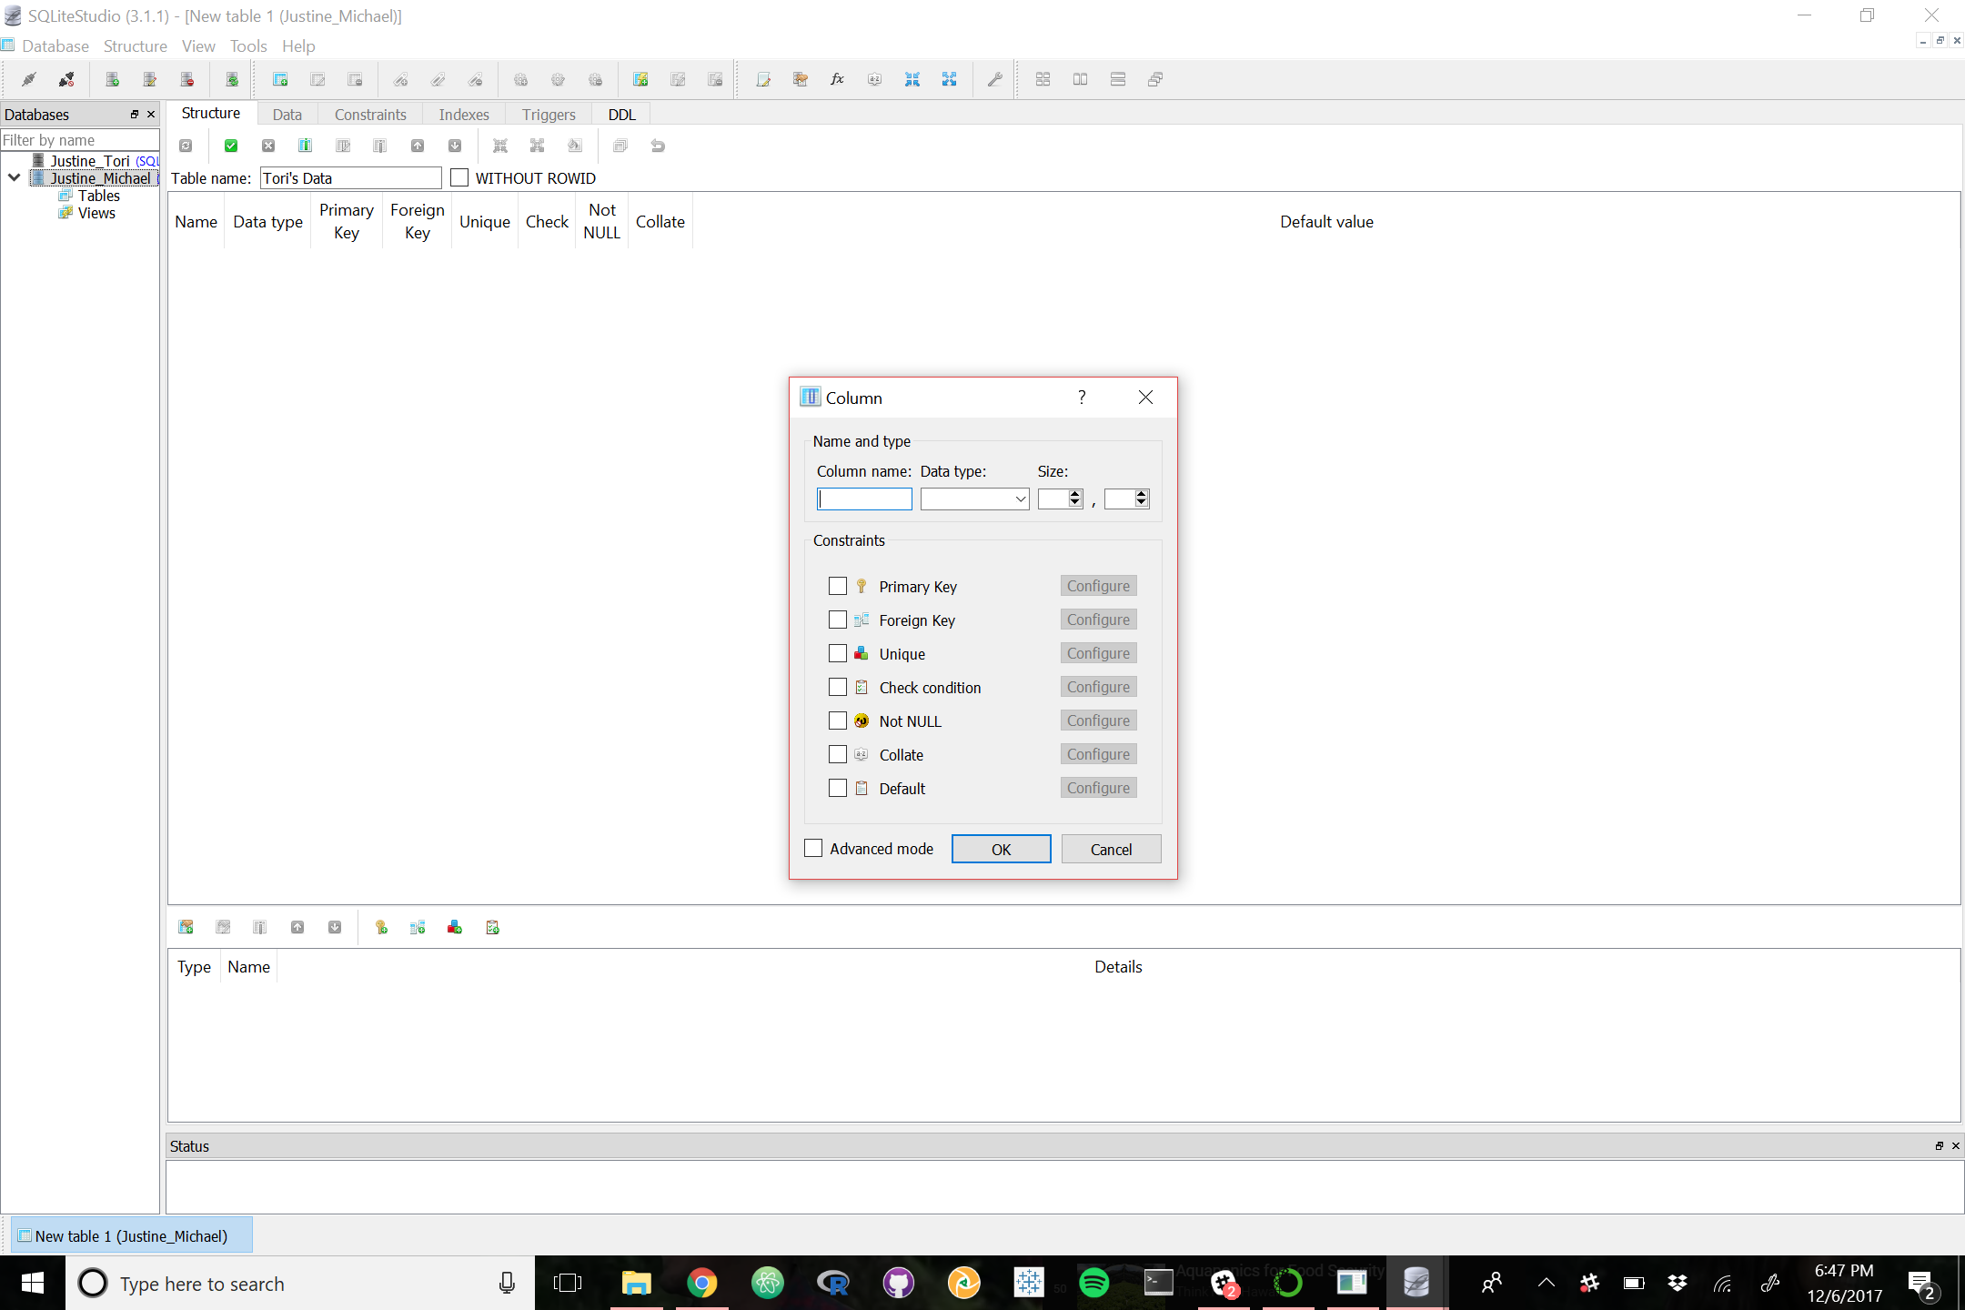

Slide 6
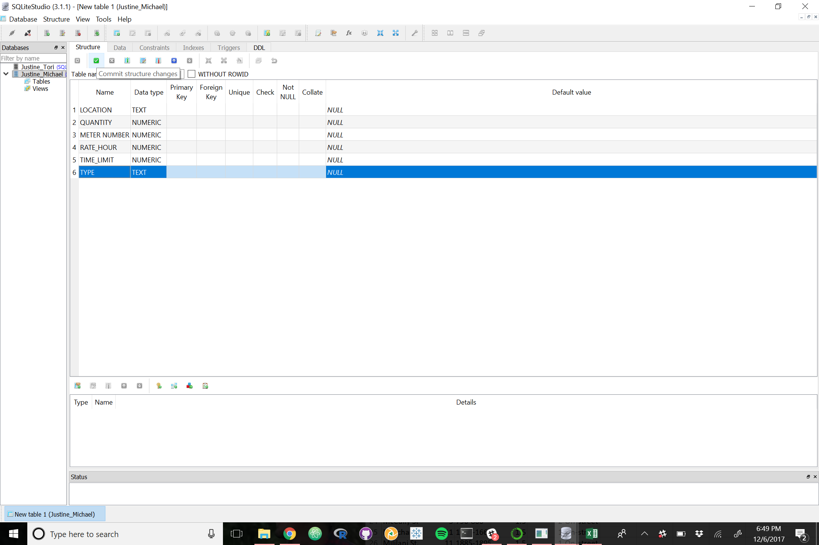

Slide 7
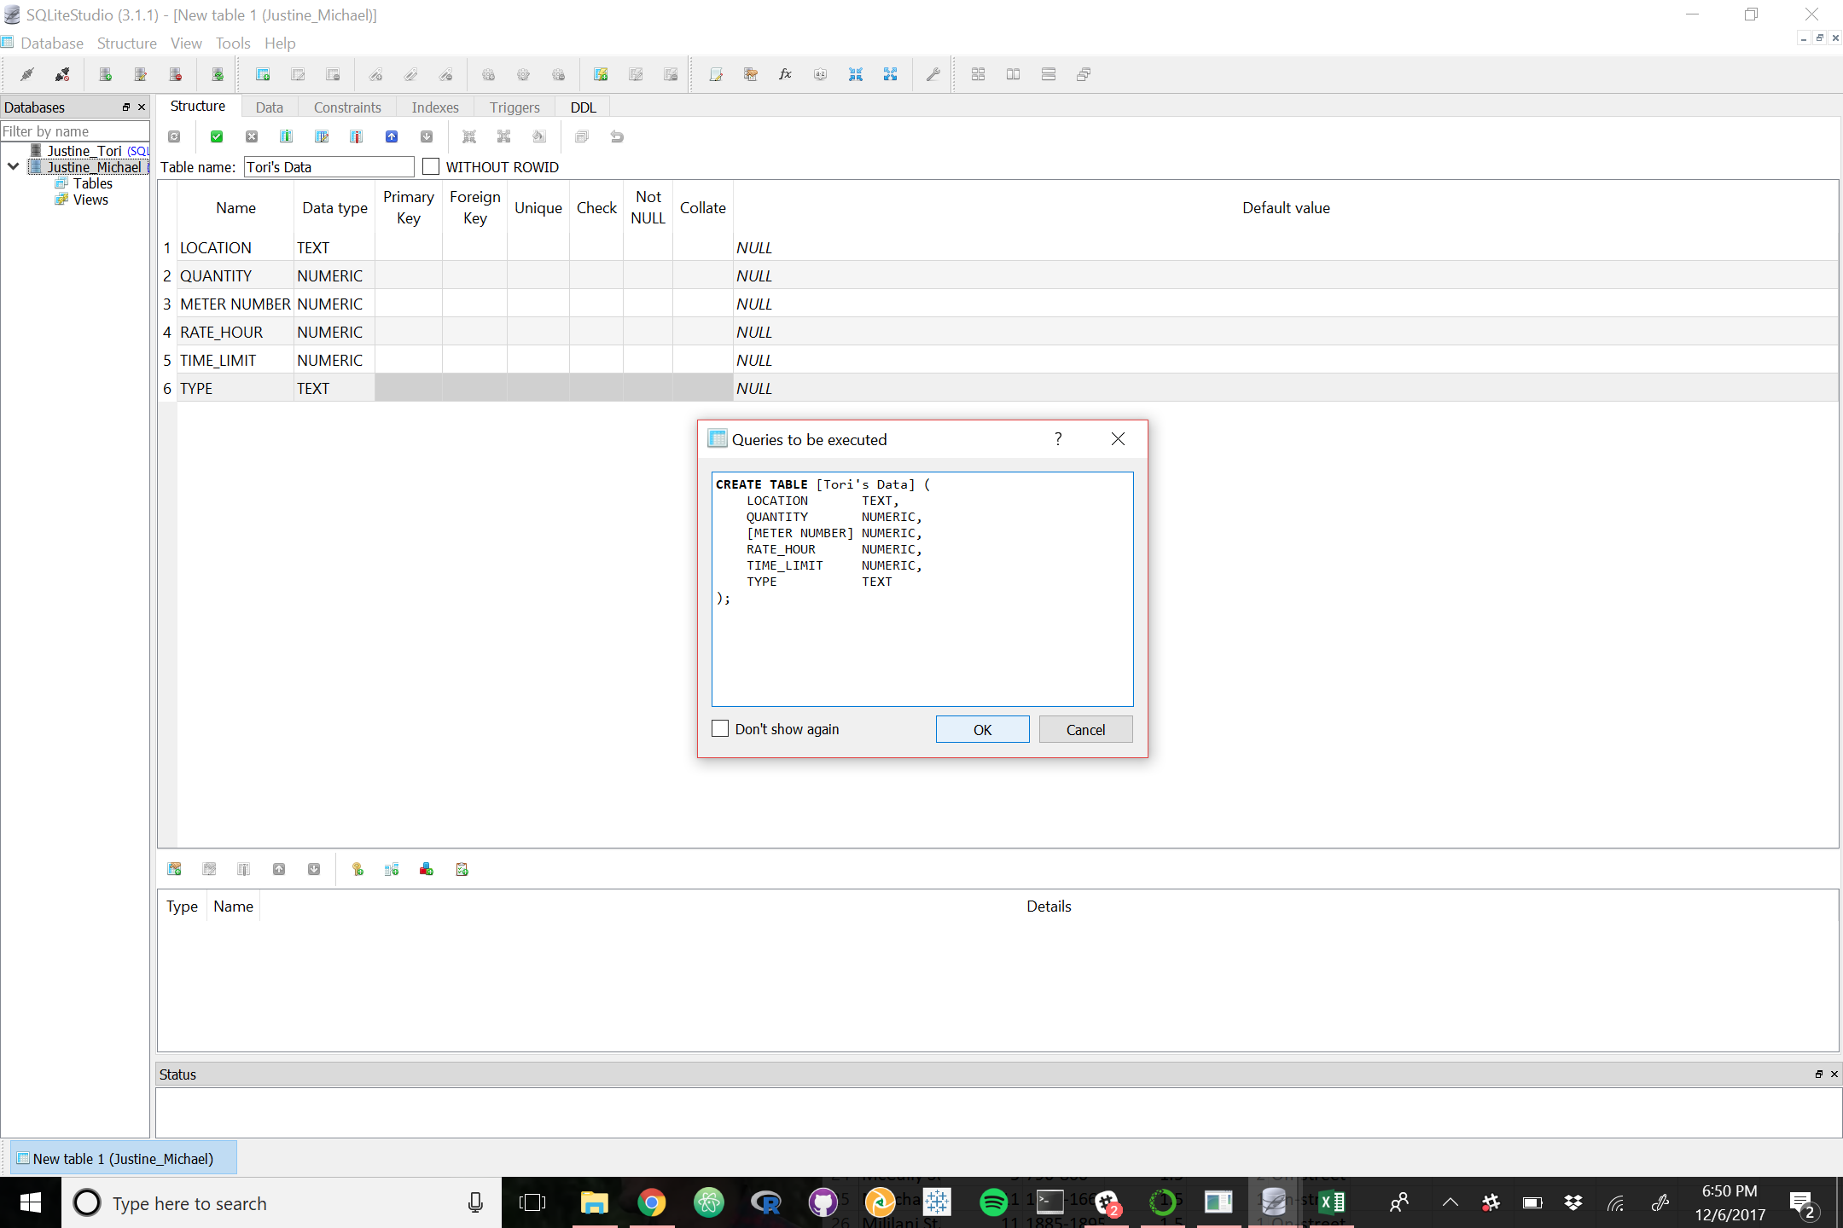

Slide 18
Fin

